Slide 1
Food Image Detection and Calories Estimation
Rutuja Tambe

Slide 2
Workflow
Introduction​
Dataset Collection and preprocessing
Model Training
Model Evaluation
Results

Slide 3
Introduction
Focus: Detecting food items from images and estimating their calorie content
Used CNN model for training the food image dataset.
Essential for dietary monitoring and health management.
Objectives: Accurately identify food items and provide calorie information

Slide 4
Dataset Collection and Preprocessing
Source: Kaggle
The dataset I have taken is from Kaggle’s website by combining two different datasets.
The dataset contains various images of each food item.
I have taken total 26 classes to train the model for food image detection in this project.
Preprocessed the images dataset by resizing all the images in the dataset.
Extracted features from the images.
Split the dataset into test and train dataset.

Slide 5
Model Training
CNN: used for training the dataset.
CNNs are a type of deep learning model to process structured grid data ,like images.
They are particularly effective for tasks involving image recognition and classification.
it has several types of layers, including convolutional layers, pooling layers, and fully connected layers.
In this CNN model combined the features extracted from the images .
Map the features with the images and train it on 100 epochs.

Slide 6
Model Evaluation
Accuracy: the Test accuracy for the model trained is 87%.
Training Accuracy: The training accuracy increases steadily and reaches around 0.8 (80%) towards the end of the training.
Validation Accuracy: The validation accuracy improves rapidly and stabilizes around 0.9 (90%) after about 30 epochs
Training Loss: The training loss decreases steadily and reaches a value close to 0.5 by the end of the training.
Validation Loss: The validation loss drops quickly and stabilizes around 0.5 after about 20 epochs.

Slide 7
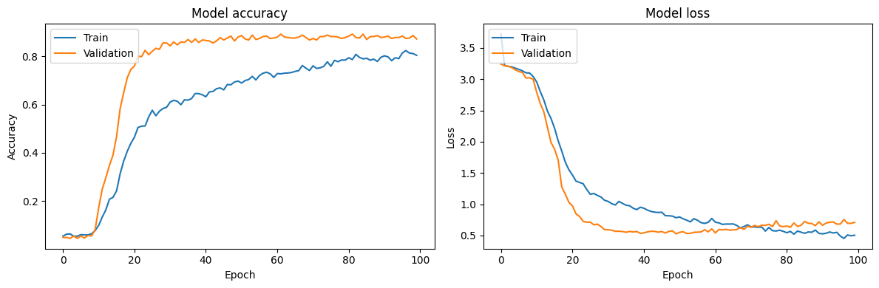

Slide 8
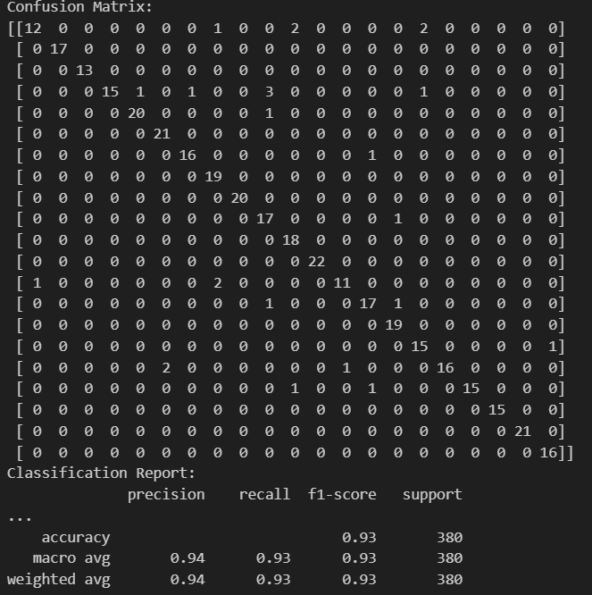
The following figure shows the confusion matrix of the trained model

Slide 9
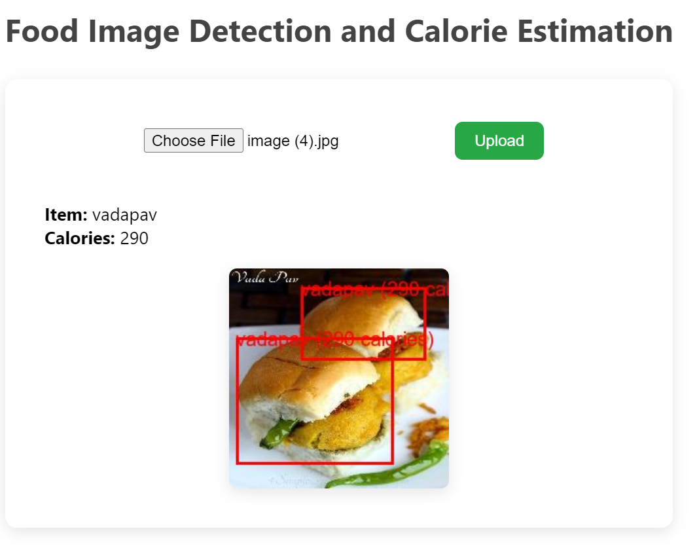
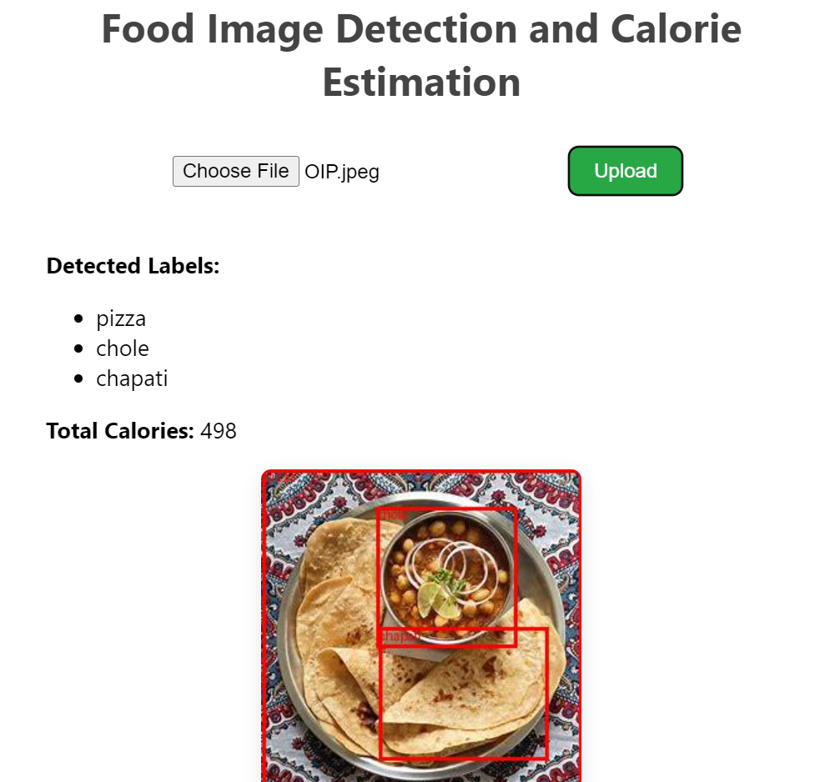
Results The model is predicting the class and giving the caloires according to it.

Slide 10
